Slide 2
Chaos Engineering in a Serverless World
Divya Mohan

Slide 3

Chaos Engineering in a Serverless World
“I love being oncall during production outages!”
-- No one ever in the IT industry

Slide 4
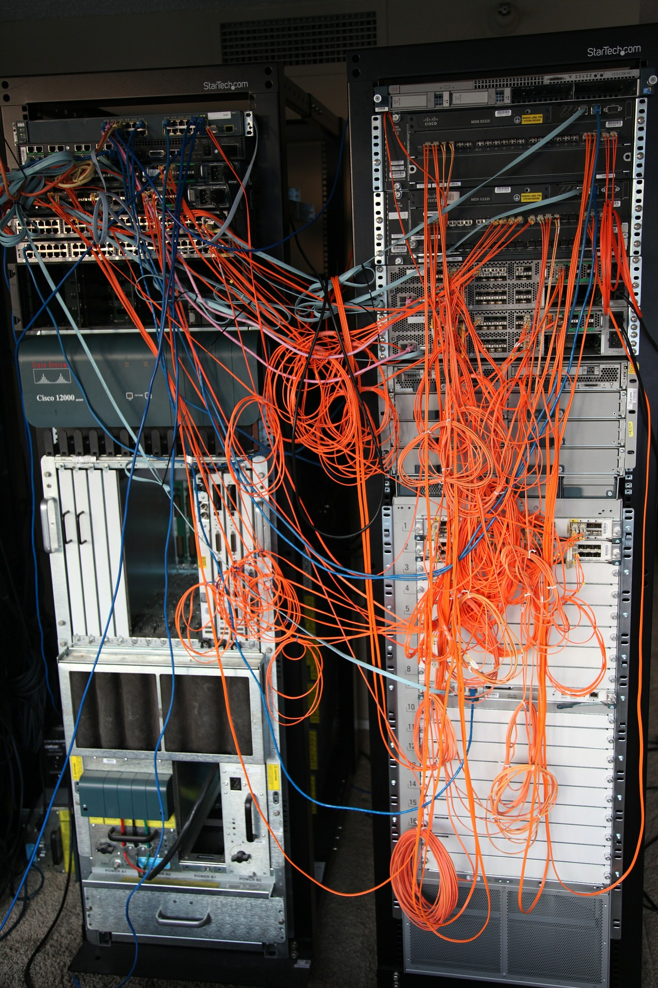
Chaos Engineering in a Serverless World
“Everything fails, all the time”
-- Werner Vogels

Slide 5
Chaos Engineering in a Serverless World
What is Chaos Engineering NOT?
Not breaking systems/apps in PRODUCTION
Not a substitute for testing
Not an exclusion of people/processes via AUTOMATION
Not a substitute for poor planning &/or policies

Slide 6
Chaos Engineering in a Serverless World
Chaos Engineering is the discipline of experimenting on a system in order to build confidence in the system’s capability to withstand turbulent conditions in production
-- principlesofchaos.org

Slide 7
Chaos Engineering in a Serverless World
“By 2023, 40% of organizations will implement chaos engineering practices as part of DevOps initiatives, reducing unplanned downtime by 20%”
-- Gartner, 2020

Slide 8

Chaos Engineering in a Serverless World
Serverless = Distributed!

Slide 9

Chaos Engineering in a Serverless World
All about the Chaos monkey

Slide 10
Chaos Engineering in a Serverless World
What’s next?
Simple Chaos experiments on local pet projects
Game days on lower environments at an enterprise level to build confidence in Chaos Engineering as a discipline

Slide 11
Chaos Engineering in a Serverless World
See you around!
Twitter: @Divya_Mohan02
LinkedIn: www.linkedin.com/in/divya-mohan0209
Website: www.divya-mohan.com

